Slide 1
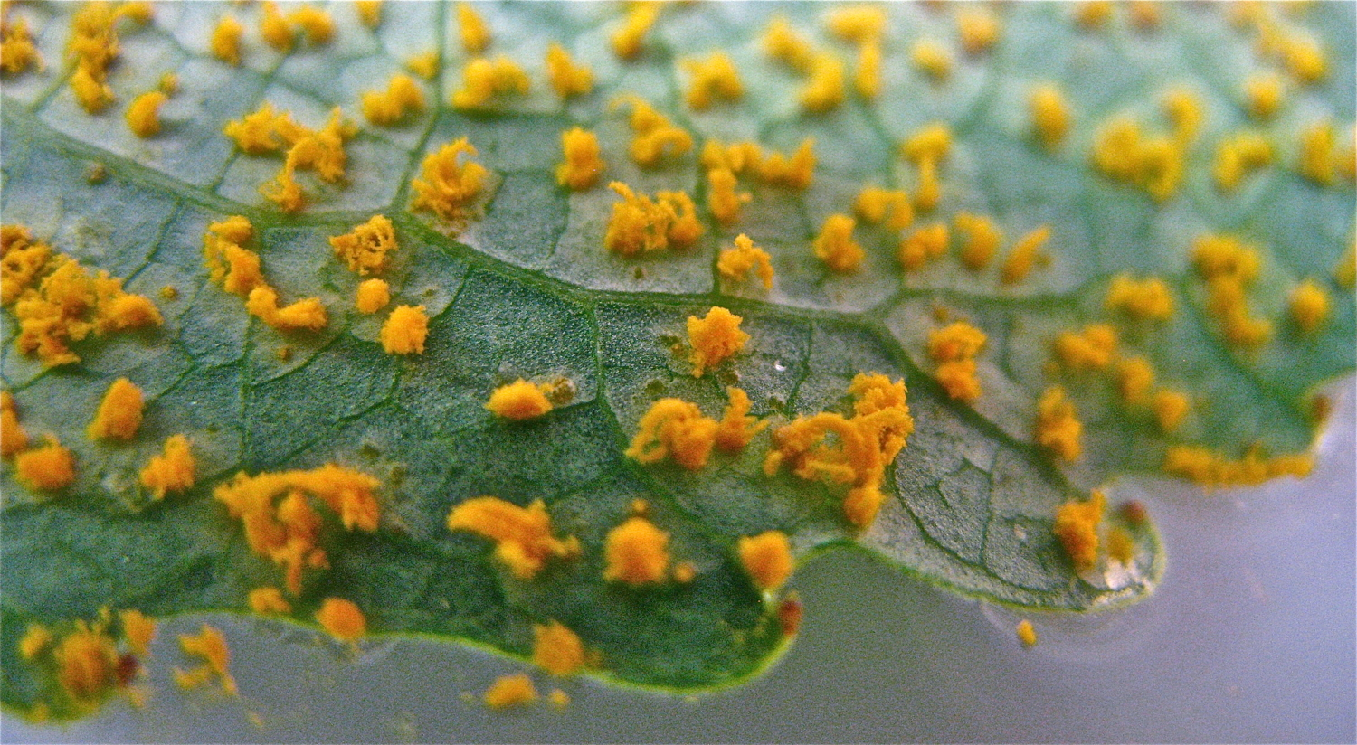
Genetic control of resistance in the interaction
Between black poplar and rust fungus
Plantcelltechnology.com
Firza Riany
Master of Science in Agriculture and Forestry
University of Eastern Finland and AgroParisTech

Slide 2
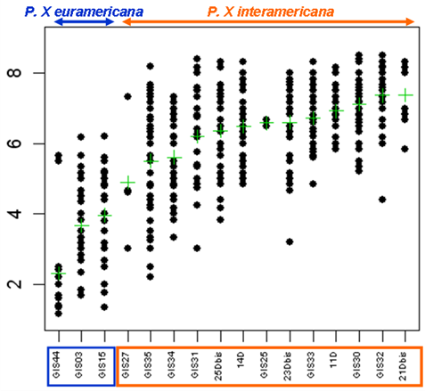
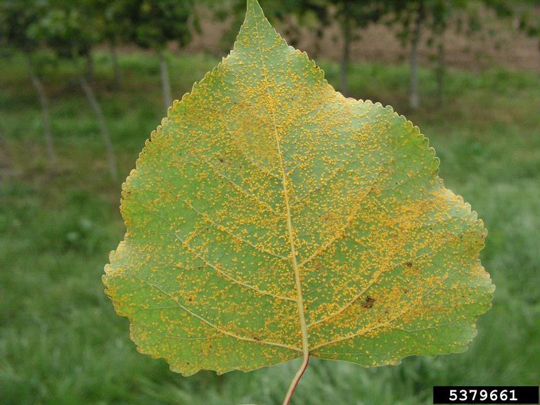
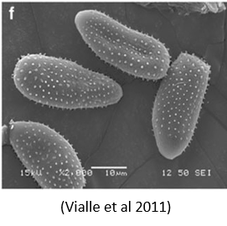


Introduction
THE SEARCH FOR
DURABLE RESISTANCE
P. deltoides x P. nigra
P. deltoides x P. trichocarpa
Higher resistance
Showing that probably P. nigra is supporting the resistance in P. euramericana
Management of hybrid poplars with resistance does not stop the Mlp from overcoming their resistance;
Lead to more infection in Populus spp. and to economic losses
2

Slide 3
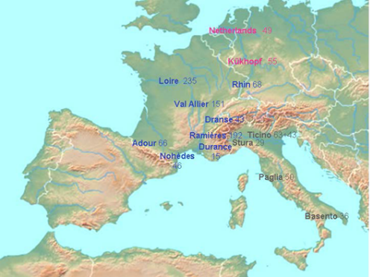
Introduction
Materials and method
OBJECTIVES OF
THE STUDY
MATERIALS
Observing the resistance in Populus nigra
Data collection from laboratory trials.
Exploratory data analysis (EDA).
Mostly are from France
Depicting the genetic control of resistance
Checking the variables needed for GWAS
Running GWAS
Results interpretation
Evaluating the interaction between P. nigra and several rust strains
154 P. nigra genotypes collected from 12 river basin in Western Europe
3 rust strains isolated from their populations
3 resistance components: latent period, uredinia number and uredinia size
Preparing the variables needed for mixed-effects model
Running mixed-effects model
Results interpretation

Slide 4
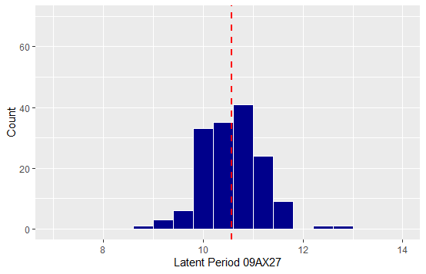
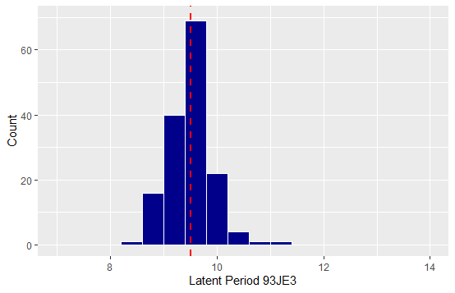
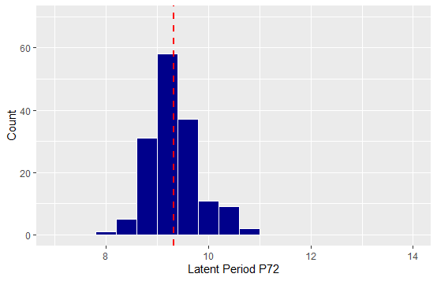
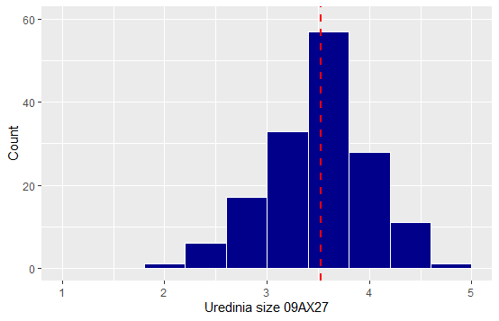
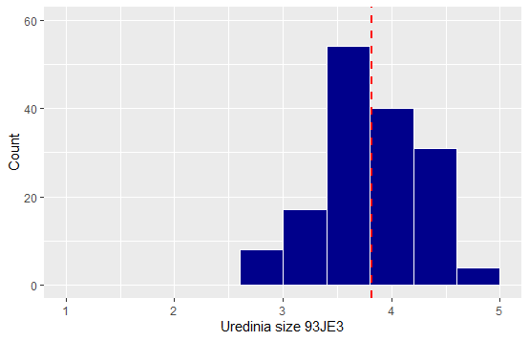
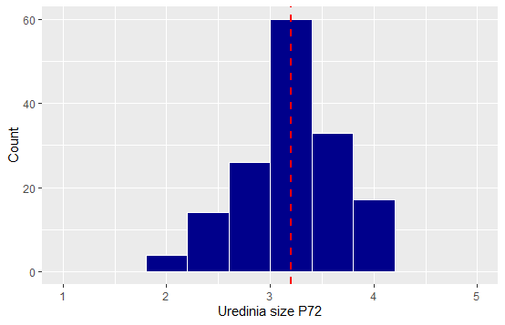
Analyses and Results
OBSERVING THE RESISTANCE
IN BLACK POPLARS FROM EDA
09AX27
Inoc. Press: 564 (40%)
93JE3
Inoc. Press: 364
(96%)
P72
Inoc. Press: 472
(91%)
60
40
Latent period
20
0
8
10
12
14
8
10
12
14
8
10
12
14
60
40
Uredinia size
20
0
1
2
3
4
5
1
2
3
4
5
1
2
3
4
5

Slide 5
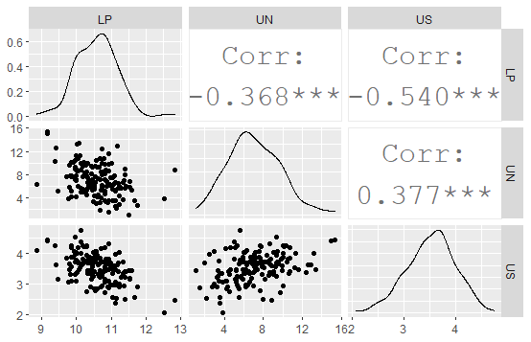
Analyses and Results
OBSERVING THE RESISTANCE
IN BLACK POPLARS FROM EDA
Observing the correlations between the resistance components
To give an idea about their synergy for poplar’s overall resistance
Preliminary analysis to explore the genetic correlation between the components using multivariate analysis
Negative correlation
Positive correlation

Slide 6
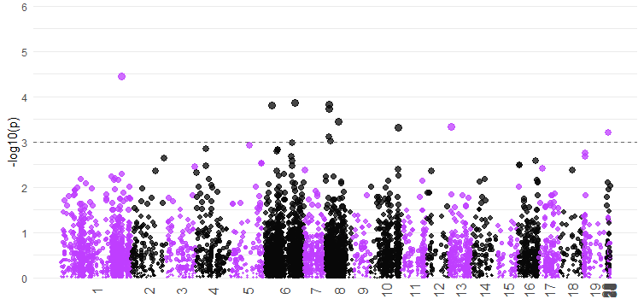
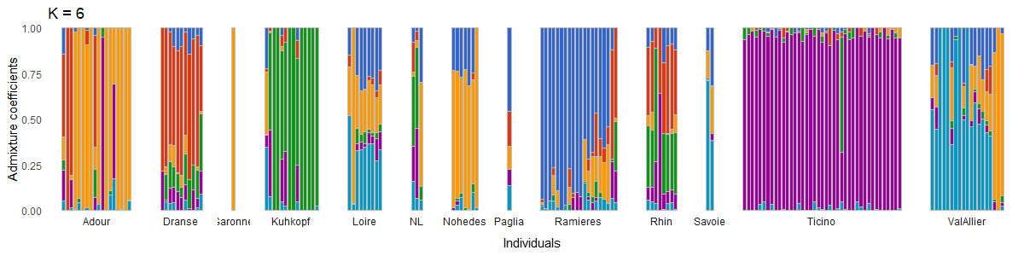
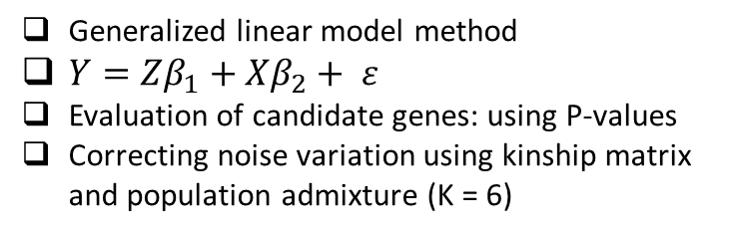
Analyses and Results
DEPICTING THE GENETICS OF RESISTANCE USING GWAS
The results
Cut-off P-value: 0.001, marker R² = 8 – 13%
Found 80 candidate genes in total for all the resistance components and rust strains
The materials
Genomic matrix: 154 genotypes x 7 800 SNPs
Latent period P72
- Triose-phosphate Transporter family
- Acetyltransferase (GNAT) family
- Glycosyl hydrolases family 16
The model
Serine Threonine Protein Kinase
YL1 nuclear family protein
Heavy-metal-associated domain
Generalized linear model method
$Y=Zβ_{1}+Xβ_{2}+ ε$
Evaluation of candidate genes: using P-values
Correcting noise variation using kinship matrix and population admixture (K = 6)
Flavonoid biosynthesis

Slide 7
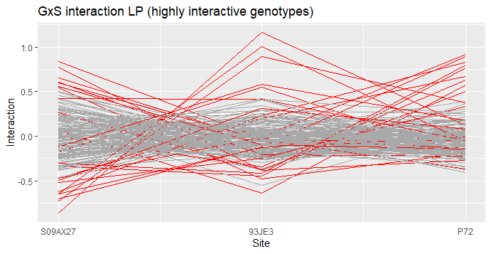
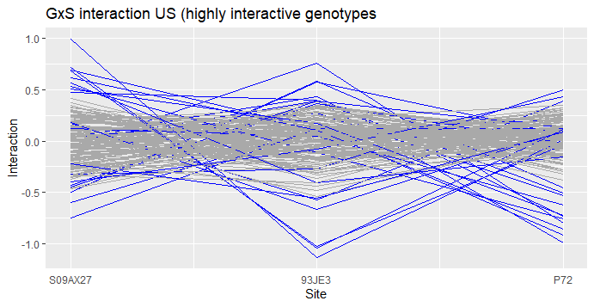
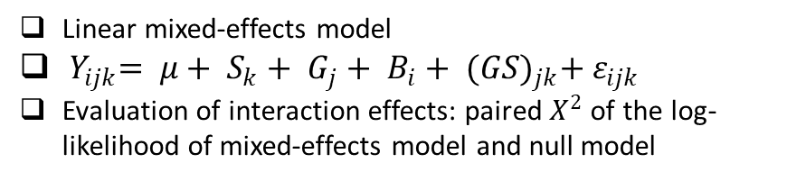
Analyses and Results
EVALUATING THE INTERACTION EFFECTS
The materials
154 black poplar genotypes inoculated with 3 rust strains
3 resistance components: latent period, uredinia number and uredinia size
The model
Linear mixed-effects model
${ Y}_{ijk}= μ+ S_{k}+ G_{j}+ B_{i}+ {(GS)}_{jk}+ ε_{ijk}$
Evaluation of interaction effects: paired $X^{2}$ of the log-likelihood of mixed-effects model and null model
The results
Interaction effects were significant, explaining 20% of variation in latent period and uredinia size
Indication of strain-specificity of the resistance components

Slide 8

Future Perspectives
THE IMPACTS OF THE STUDY FOR POPLAR’S BREEDING PROGRAM
Confirming the candidate genes for marker-assisted selection
Through further research on the genes’ regulation pathways and functions
Selecting a group of poplars with various resistance across the strains
A group of poplars with stable resistance across the strains but with various strain-specificity to reduce the possibility of exerting selection pressure on the rust.
Improving GWAS
By testing more genotypes with more rust strains to increase the statistical power.
Confirming the genetic control of the resistance’s strain-specificity
To see if the specificity is genetically controlled or not by modeling the association between interaction parameters and SNPs

Slide 9
Genetic control of resistance in the interaction between black poplar and rust fungus
Firza Riany (firzariany2@gmail.com)

